Slide 1

MESSAGE AUTHENTICATION CODE
CHAPTER 11

Slide 2
Outlines
Introduction to Message Authentication and Message Authentication Code.
Security on Message Authentication Code.
The Design of Practical Message Authentication Codes.

Slide 3
Learning Objectives
In the end of this Chapter 11, students will be able:
To understand the concept and importance of message authentication code in cryptography.
To understand the security concerns on message authentication code.
To learn the design of practical message authentication codes.

Slide 4
INTRODUCTION TO MESSAGE AUTHENTICATION

Slide 5
Message Authentication Requirements
In the context of communication across insecure network channel, message authentication is essential, as an adversary could launch any of the following attack:
Disclosure (Confidentiality). The release of message contents to any person or process not possessing the appropriate cryptographic key.
Traffic Analysis (Confidentiality). The discovery of the pattern of traffic between parties such as the length and number of encrypted message transmitted through the channel.

Slide 6
Message Authentication Requirements
Masquerade (Integrity). An insertion of messages into the network from a fraudulent source, which includes unauthorized creation and fraudulent acknowledgements of messages by unauthorized party.
Content Modification (Integrity). Changes to the contents of a message, including insertion, deletion, transposition, and modification.
Sequence Modification (Integrity). Any modification to a sequence of messages between parties, including insertion, deletion, and reordering.

Slide 7
Message Authentication Requirements
Timing Modification (Integrity). Delay or replay of messages.
Source Repudiation (Non-repudiation). Denial of transmission of message by source.
Destination Repudiation (Non-repudiation). Denial of receipt of message by destination.

Slide 8
Message Authentication Functions
Any message authentication or digital signature mechanism has two levels of functionality.
Lower Level. There must be some sort of function that produces an authenticator: a value to be used to authenticate a message.
Higher Level. This level uses the lower-level function as a primitive in an authentication protocol that enables a receiver to verify the authenticity of a message.

Slide 9
Message Authentication Functions
The types of functions that produce an authenticator:
Hash Function. A function that maps a message of any length into a fixed-length hash value which serves as the authenticator.
Message Encryption. The ciphertext of the entire message serves as its authenticator.
Message Authentication Code (MAC). A function of the message and a secret key that produces a fixed-length value that serves as the authenticator.

Slide 10
MESSAGE AUTHENTICATION FUNCTION MESSAGE ENCRYPTION

Slide 11
Message Authentication Functions - Message Encryption
Message encryption by itself can provide a measure of authentication, either via symmetric encryption or public-key encryption.
Symmetric encryption that provide confidentiality and authentication.
Public-key encryption that provide confidentiality.
Public-key encryption that provide authentication and signature.
Public-key encryption that provide confidentiality, authentication and signature.

Slide 12
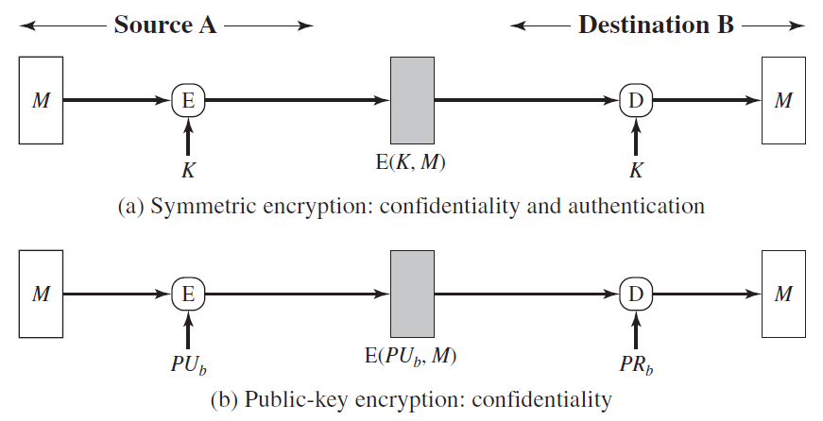
Message Authentication Functions - Message Encryption

Slide 13
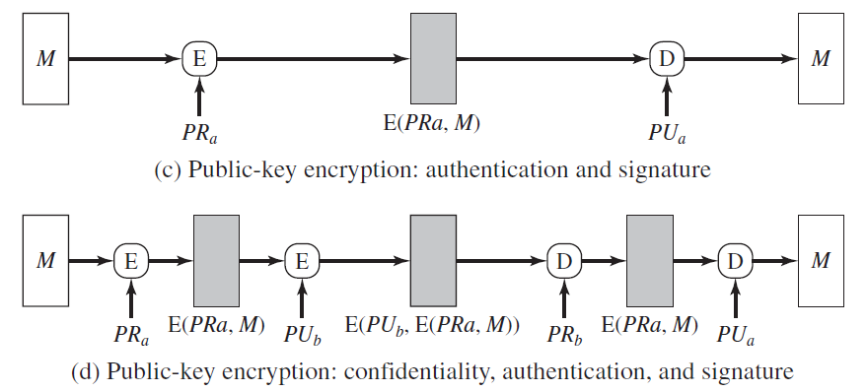
Message Authentication Functions - Message Encryption

Slide 14
MESSAGE AUTHENTICATION FUNCTION MESSAGE AUTHENTICATION CODE (MAC)

Slide 15
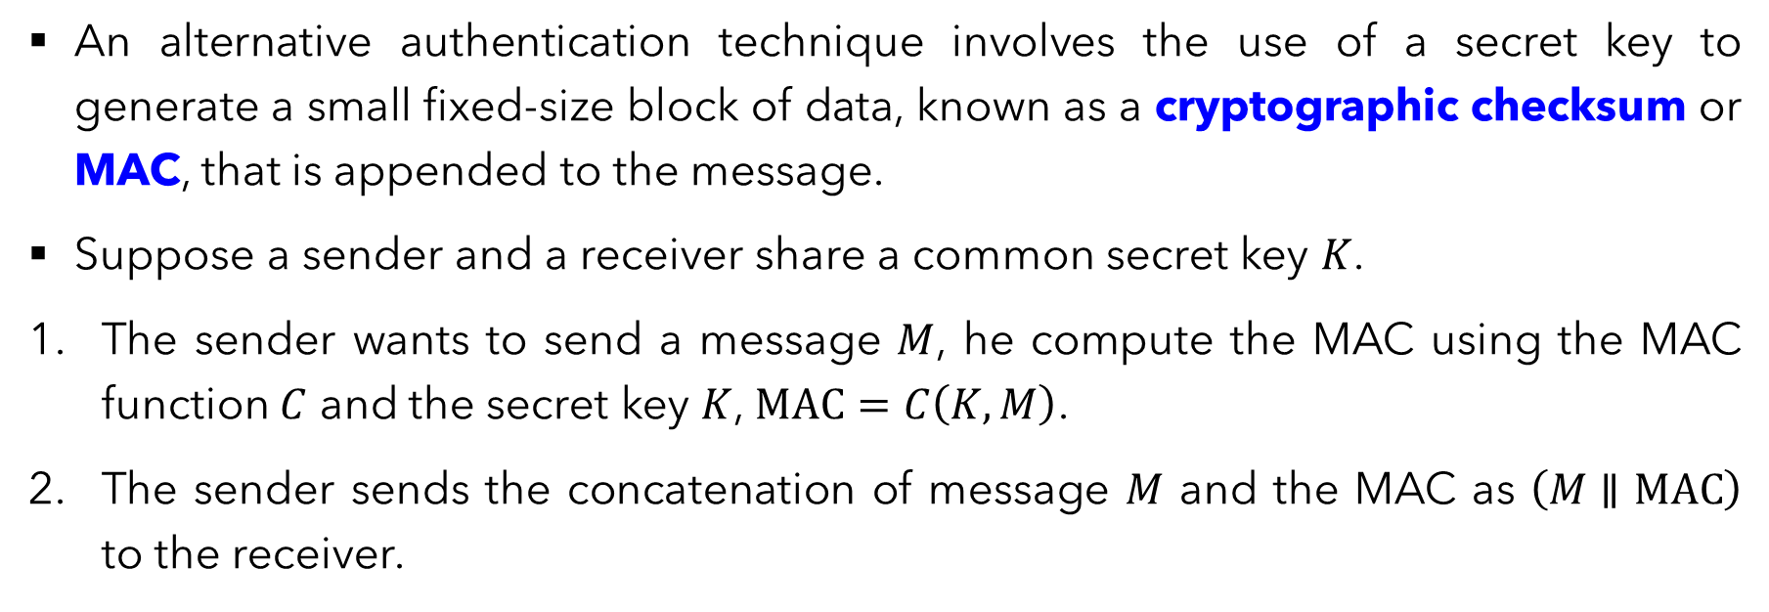
Message Authentication Functions - Message Authentication Code (MAC)
An alternative authentication technique involves the use of a secret key to generate a small fixed-size block of data, known as a cryptographic checksum or MAC, that is appended to the message.
Suppose a sender and a receiver share a common secret key $K$.
The sender wants to send a message $M$, he compute the MAC using the MAC function $C$ and the secret key $K$, $MAC=C\left(K,M\right)$.
The sender sends the concatenation of message $M$ and the MAC as $\left(M∥MAC\right)$ to the receiver.

Slide 16
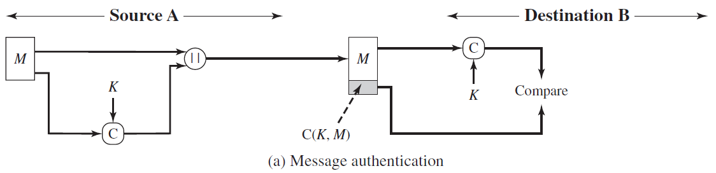
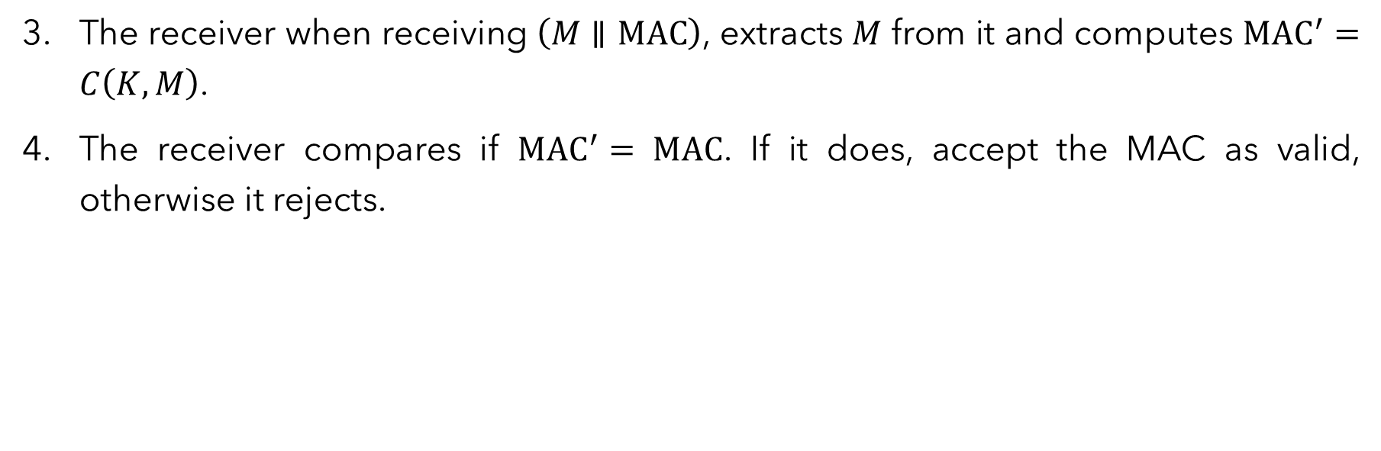
Message Authentication Functions - Message Authentication Code (MAC)
The receiver when receiving $\left(M∥MAC\right)$, extracts $M$ from it and computes ${MAC}^{′}=C\left(K,M\right)$.
The receiver compares if ${MAC}^{′}=$ $MAC$. If it does, accept the MAC as valid, otherwise it rejects.

Slide 17
Message Authentication Functions - Message Authentication Code (MAC)
A MAC function is similar to encryption with a difference that the MAC algorithm need NOT be reversible.
In general, the MAC function is a many-to-one function.
Besides the basic MAC, it can be extended to include confidentiality, with either:
The authentication tied to the plaintext.
The authentication tied to the ciphertext.

Slide 18
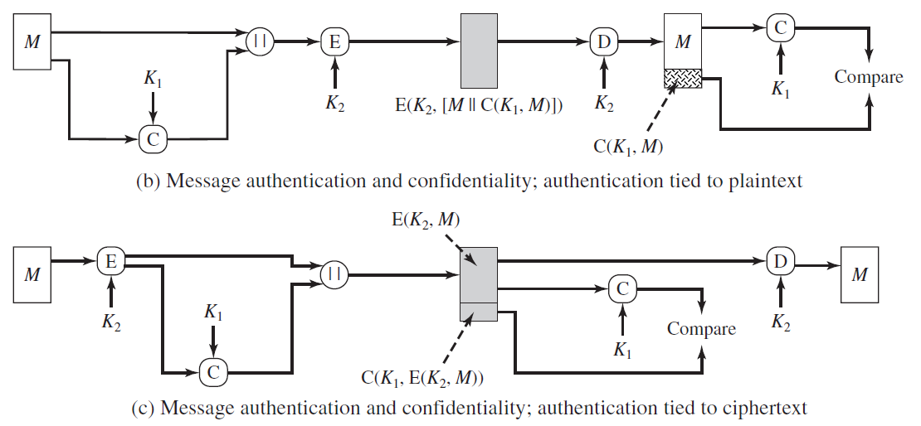
Message Authentication Functions - Message Authentication Code (MAC)

Slide 19
Message Authentication Code (MAC) – Requirements
Considering the security of the MAC, the design of MAC should satisfy the following requirements:
Security against Message Replacement Attacks. A condition where an adversary is able to construct a new message to match a given MAC, even without knowing and learning the key used.
Security against Brute Force Attack. This security is with respect to a chosen plaintext (message).
Security on the Authentication. The authentication algorithm design should not be weaker with respect to certain parts of bits of the message.

Slide 20
MESSAGE AUTHENTICATION CODE SECURITY

Slide 21
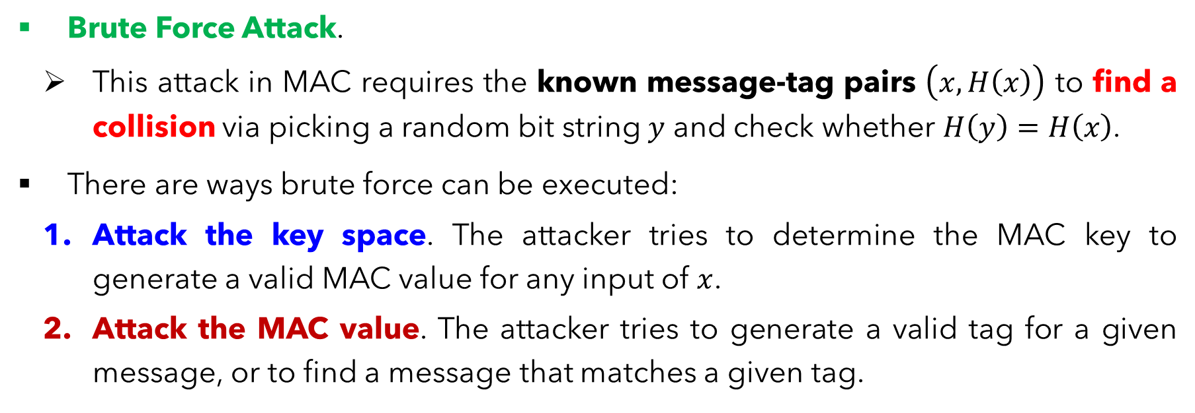
Attacks on MACs
Brute Force Attack.
This attack in MAC requires the known message-tag pairs $\left(x,H\left(x\right)\right)$ to find a collision via picking a random bit string $y$ and check whether $H\left(y\right)=H\left(x\right)$.
There are ways brute force can be executed:
Attack the key space. The attacker tries to determine the MAC key to generate a valid MAC value for any input of $x$.
Attack the MAC value. The attacker tries to generate a valid tag for a given message, or to find a message that matches a given tag.

Slide 22
Cryptanalysis on MACs
Cryptanalysis seek to exploit the property of an algorithm to perform specific attack other than exhaustive search.
An ideal MAC Algorithm will require a cryptanalytic effort greater than or equal to the brute force effort.
As there are various structures of MACs than in hash functions, discussing the general cryptanalysis is difficult here. Hence, we will NOT look into this section in MAC in this course.

Slide 23
DESIGN OF PRACTICAL MAC HASH-BASED MAC (HMAC)

Slide 24
Hash-Based MAC – Motivations & Design
In recent years, there has been increased interest in developing a MAC derived from a cryptographic hash function.
Motivations behind such interest:
Cryptographic hash functions such as MD5 and SHA generally execute faster in software than symmetric block ciphers such as DES.
Library code for cryptographic hash functions is widely available.

Slide 25
Hash-Based MAC – Motivations & Design
HMAC has been issued as RFC 2104, chosen as the mandatory-to-implement MAC for IP security, and is used in other Internet protocols, such as SSL. It has been issued as a NIST standard (FIPS 198).
RFC 2104 lists the following design objectives for HMAC.
To use, without modifications, available hash functions.
To allow for easy replaceability of the embedded hash function in case faster or more secure hash functions are found or required.

Slide 26
Hash-Based MAC – Motivations & Design
To preserve the original performance of the hash function without incurring a significant degradation.
To use and handle keys in a simple way.
To have a well understood cryptographic analysis of the strength of the authentication mechanism based on reasonable assumptions about the embedded hash function.

Slide 27
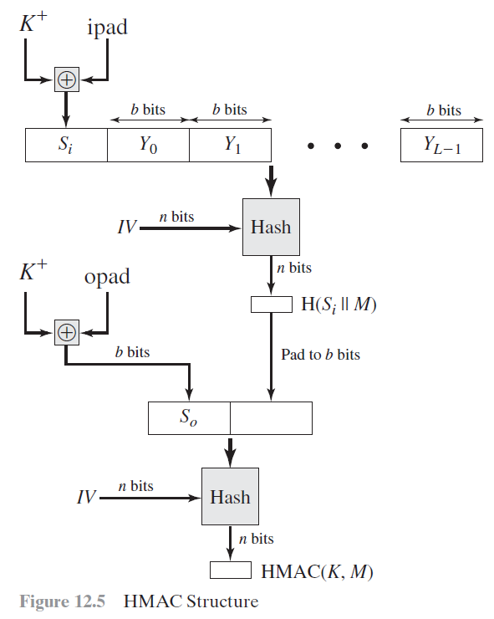
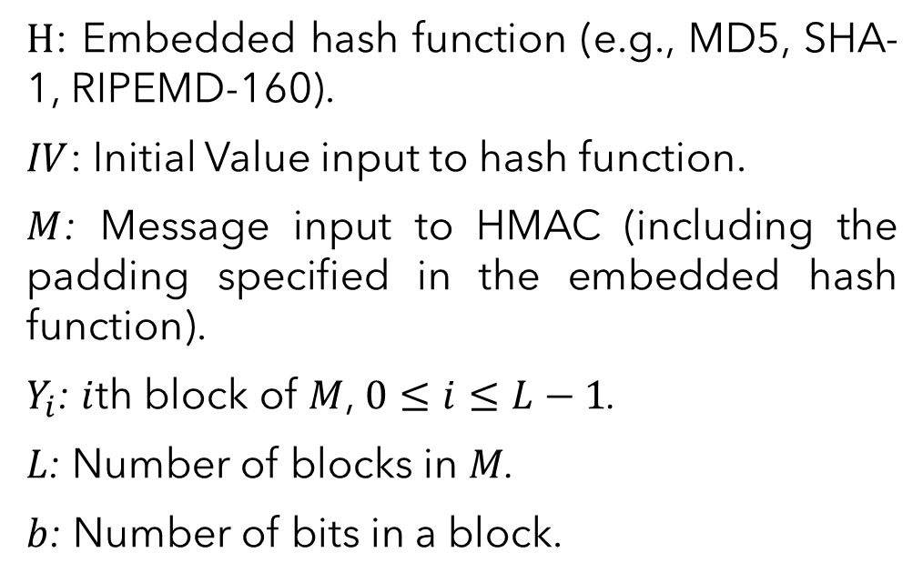
Hash-Based MAC – Motivations & Design
$H$: Embedded hash function (e.g., MD5, SHA-1, RIPEMD-160).
$IV$: Initial Value input to hash function.
$M$: Message input to HMAC (including the padding specified in the embedded hash function).
$Y_{i}$: $i$th block of $M$, $0≤i≤L−1$.
$L$: Number of blocks in $M$.
$b$: Number of bits in a block.

Slide 28
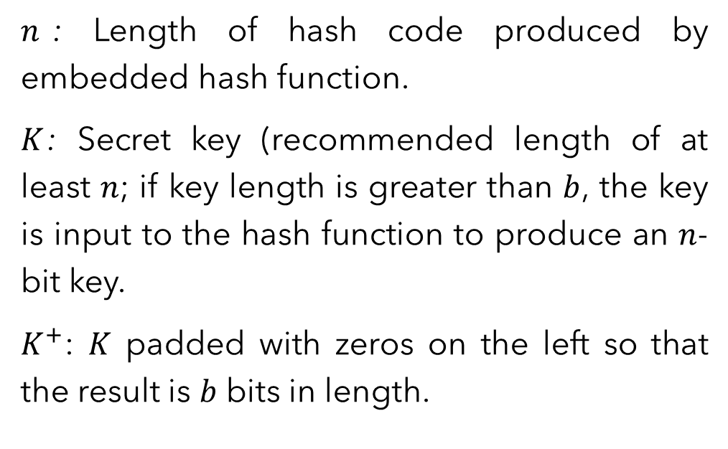
Hash-Based MAC – Motivations & Design
$n$: Length of hash code produced by embedded hash function.
$K$: Secret key (recommended length of at least $n$; if key length is greater than $b$, the key is input to the hash function to produce an $n$-bit key.
$K^{+}$: $K$ padded with zeros on the left so that the result is $b$ bits in length.

Slide 29
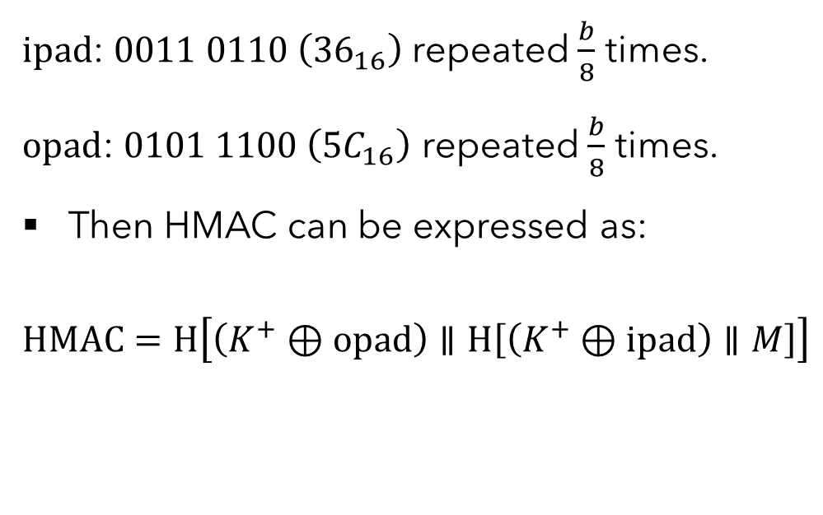
Hash-Based MAC – Motivations & Design
$ipad$: $0011 0110 \left({36}_{16}\right)$ repeated $\frac{b}{8}$ times.
$opad$: $0101 1100 \left({5C}_{16}\right)$ repeated $\frac{b}{8}$ times.
Then HMAC can be expressed as:
$$HMAC=H\left[\left(K^{+}⊕opad\right)∥H\left[\left(K^{+}⊕ipad\right)∥M\right]\right]$$

Slide 30
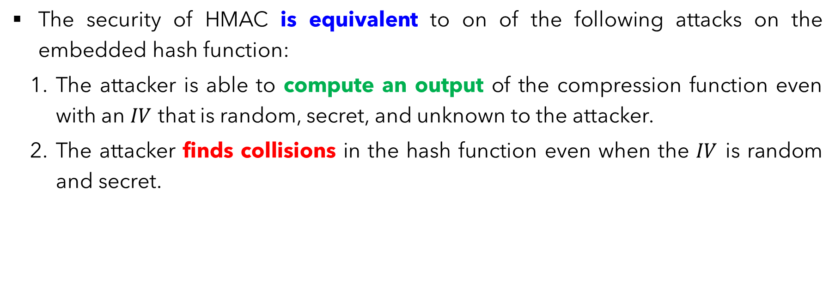
Hash-Based MAC – Security
The security of HMAC is equivalent to on of the following attacks on the embedded hash function:
The attacker is able to compute an output of the compression function even with an $IV$ that is random, secret, and unknown to the attacker.
The attacker finds collisions in the hash function even when the $IV$ is random and secret.

Slide 31
DESIGN OF PRACTICAL MAC MACs Based on BLOCK CIPHERS

Slide 32
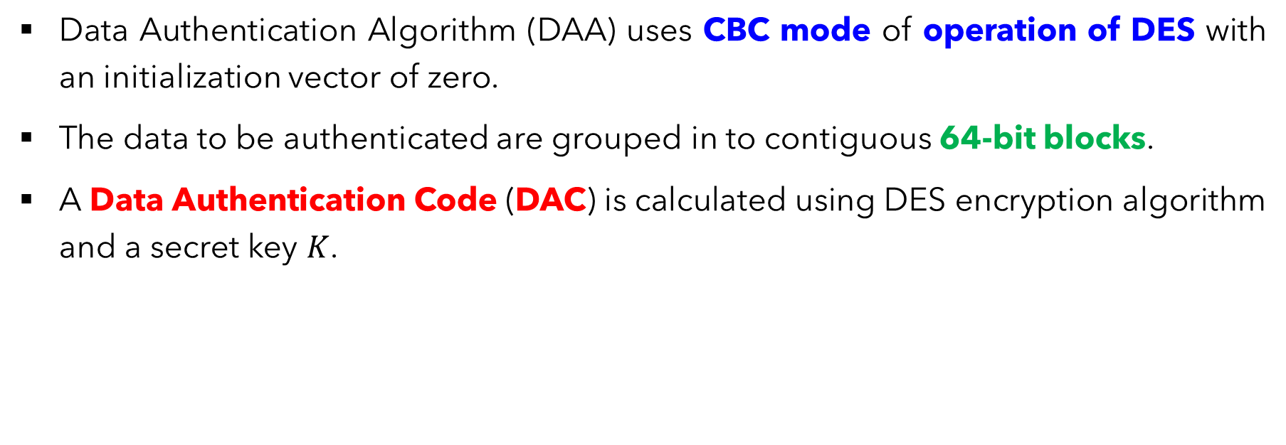
MAC Based on Block Ciphers – Data Authentication Algorithm (DAA)
Data Authentication Algorithm (DAA) uses CBC mode of operation of DES with an initialization vector of zero.
The data to be authenticated are grouped in to contiguous 64-bit blocks.
A Data Authentication Code (DAC) is calculated using DES encryption algorithm and a secret key $K$.

Slide 33
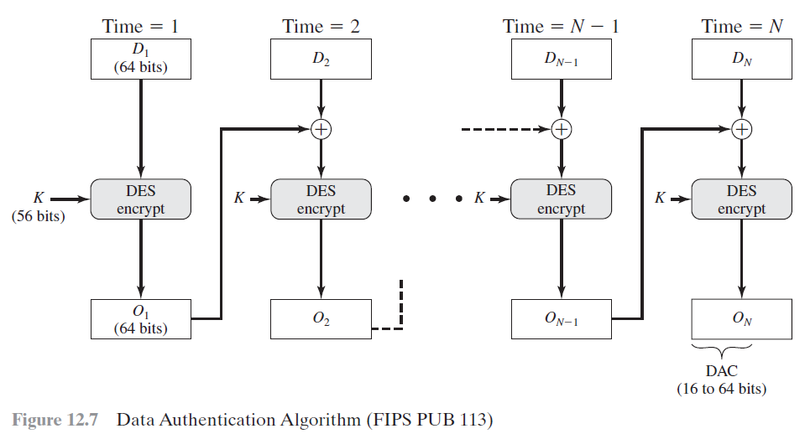

Slide 34
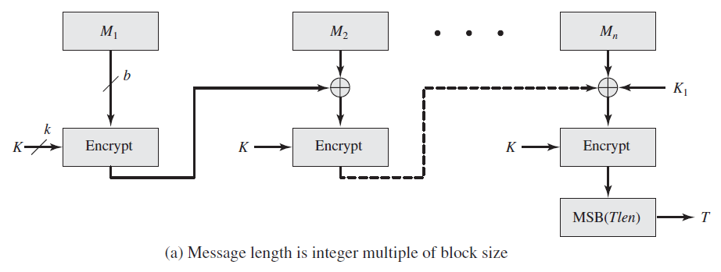
MAC Based on Block Ciphers – Cipher-Based MAC (CMAC)

Slide 35
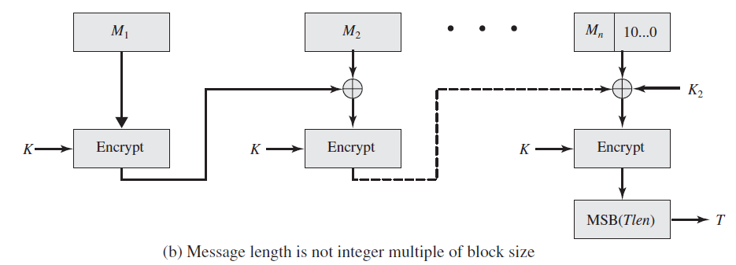
MAC Based on Block Ciphers – Cipher-Based MAC (CMAC)

Slide 36
Message Authentication Code OTHER PRACTICAL MACs

Slide 37
Other Practical MACs
Authentication Encryption (AE). A term used to describe encryption systems that simultaneously protect confidentiality and authenticity of communications.
Counter with Cipher Block Chaining-Message Authentication Code (CCM).
Galois/Counter Mode (GCM).
Pseudorandom number generation (PRNG).

Slide 38
Main References for Chapter 11
Forouzan, B.A. “Introduction to Cryptography and Network Security”, Third Edition, McGraw-Hill, 2008.
Stallings, W. “Cryptography and Network Security: Principles and Practices”, Fifth Edition, Pearson Prentice Hall, 2011.

Slide 39
~ THE END ☺ ~

